Slide 1
Ag Markets & Covid-19
-- Ditch & Reservoir Company Alliance --
Tom Lipetzky
Director, Marketing Programs & Strategic Initiatives
August 13, 2020

Slide 2
A Lot Has Happened Since We Last Talked
The Covid-19 pandemic has pretty much turned our world’s upside down.
Major shift in retail and foodservice environments.
Continued intensification among consumers to buy local.
Oil prices, if only temporarily, dropped to below zero.
Supply chain disruptions and market shocks.
Increased government spending in support of agriculture.
Courtesy of Allison Porter & 2019 AgInsights Photo Contest

Slide 3
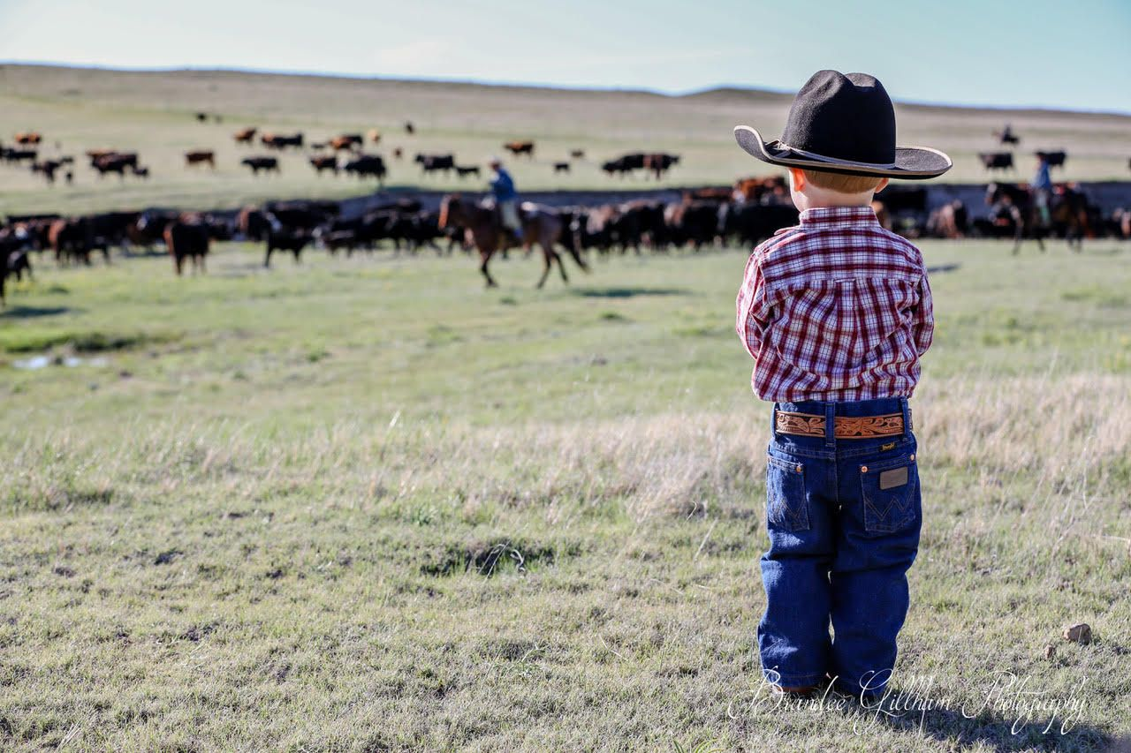
Tonight’s Discussion
CDA Response
Current Sentiment
Market Trends
Government Spending
Farm Income Projections
Discussion
Photo courtesy of Brandee Gillham & 2019 AgInsights Photo Contest

Slide 4
CDA Response
Throughout the crisis, CDA has continued to deliver the programs and services as expected of us by industry.
Helped staff the state emergency operations center, playing lead roles in Emergency Support Functions #11 (Agriculture & Natural Resources) and #6 (Mass Care and Emergency Assistance).
Stood up task forces to address supply chain and recovery issues, helping support the Governor’s Economic Recovery & Growth Council.
Coordination between industry and Governor’s Office relating to Public Health Orders.
Been creative in deploying new tools and strategies to help Colorado’s farmers and ranchers.
ColoradoProud.com
coloradofoodanddrinkexports.com

Slide 5
Creighton University “Rural Mainstreet Index”
Monthly survey of 200 rural bank Presidents and CEO across ten state region.
Expecting farm loan defaults to increase by 5% over the next 12 months.
One-third of bankers with local ethanol plants reported current production shutdowns, either temporary or permanent.

Slide 6
Purdue University & CME Group Ag Barometer
Monthly survey of 400 ag producers with sales >$500,000 and stratified so that respondents correspond with USDA’s Census of Agriculture.
July’s barometer reading is still 30% below the February high.
4 of 10 report doing more business online.
53% indicated they were less likely to attend in-person educational programs.

Slide 7
Farmland Partners Inc. (FPI) Denver Based REIT Owning Farmland in 16 States

Slide 8
Cash Receipts from Colorado’s Top 5 Agricultural Products -- $7.1 Billion Total in 2018 --
Source: USDA/ERS Farm Wealth & Income Statistics – Cash Receipts by State

Slide 9
Slaughter Cattle - CME

Slide 10
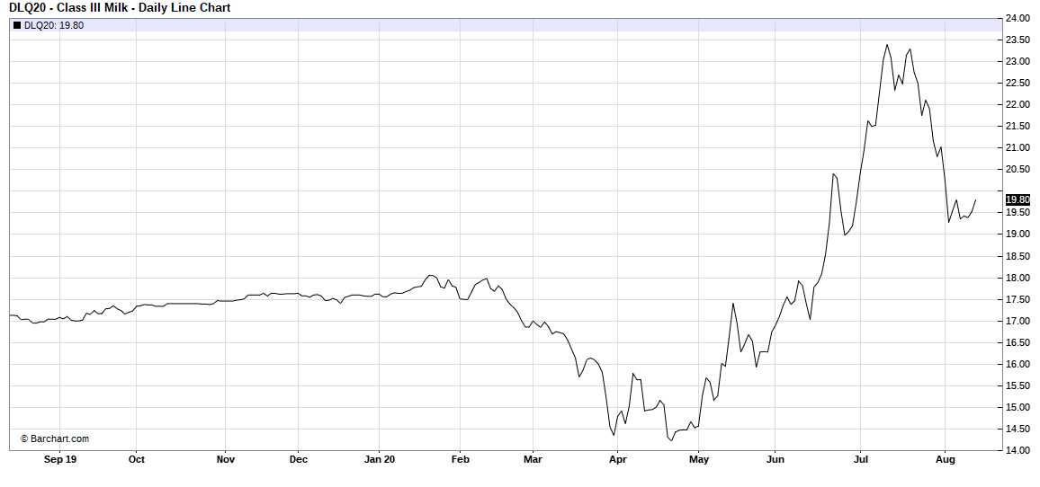
Class III Milk - CME

Slide 11
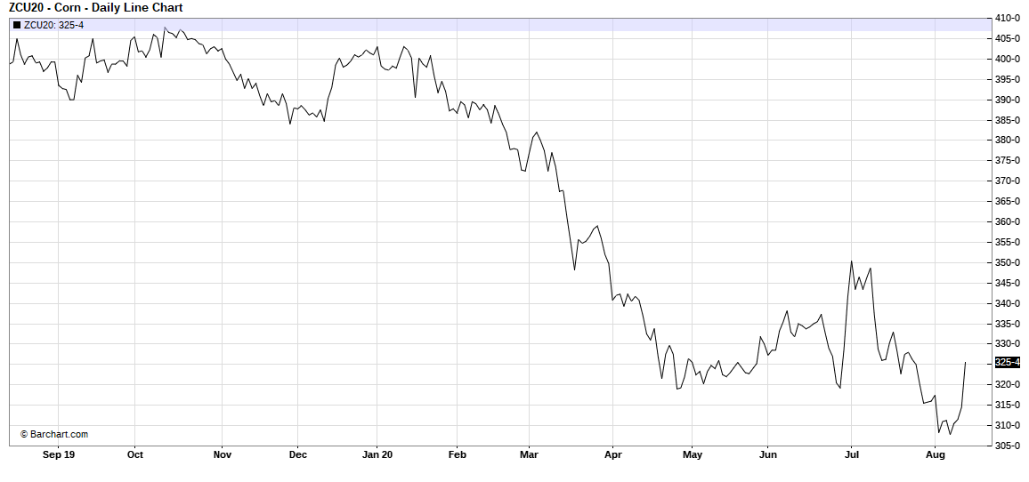
Corn - CBOT

Slide 12
Ethanol - CBOT

Slide 13
Supreme Alfalfa Hay Large Square NE Colorado FOB

Slide 14
Hard Red Wheat – Kansas City

Slide 15
U.S. Food & Ag Exports YTD – January thru June

Slide 16
U.S. Food & Ag Exports to China YTD – January thru June

Slide 17
Colorado Food & Ag Product Exports

Slide 18
Colorado Beef & BVM Exports

Slide 19
Colorado Food & Ag Exports YTD – January thru June

Slide 20
USDA Farm Programs Spending

Slide 21
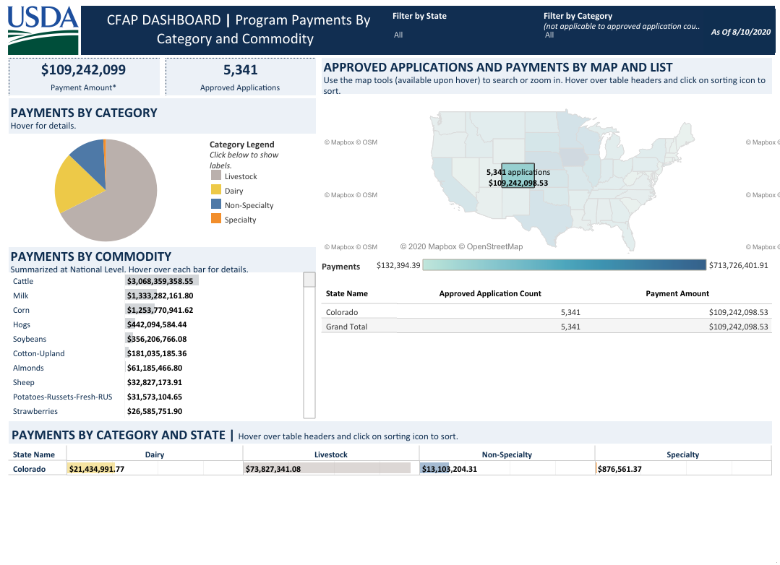
USDA’s CFAP Dashboard

Slide 22
FAPRI Estimates of U.S. Net Farm Income

Slide 23
Colorado Farm & Ranch Net Income

Slide 24
Agriculture’s Contribution to the Colorado Economy
Analysis was recently completed by CDA to determine the contribution Colorado’s agriculture industry makes to state’s economy.
2018 IMPLAN data, adjusted to reflect 2019 dollars, served as the basis for the analysis which included production agriculture, inputs, and value-added processing. Retail and Foodservice were not included.
RESULT - Colorado’s agriculture industry generated more than $47 billion of economic activity in 2019 and supported 5% of the state’s entire workforce!
Total Contribution to Colorado’s Economy from Production Agriculture and Agriculture-Related Industries
Contribution Type | Employment | % Employment | Total Value Added | % of Gross State Product | Output
Direct Effect | 101,701 | 2.7% | $7.6 Billion | 2.1% | $29.4 Billion
Indirect Effect | 49,674 | 1.3% | $5.3 Billion | 1.4% | $10.5 Billion
Induced Effect | 43,689 | 1.1% | $4.0 Billion | 1.1% | $6.9 Billion
Total Effect | 195,064 | 5.1% | $16.9 Billion | 4.6% | $46.7 Billion

Slide 25
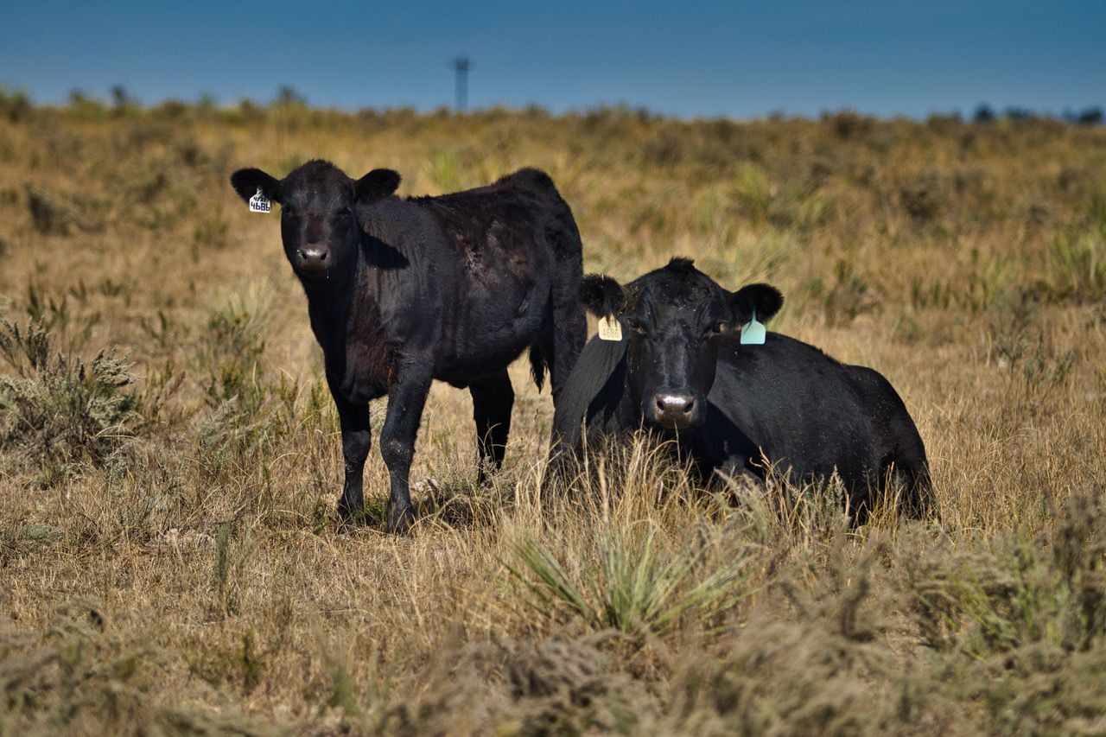
For More Information:
Tom Lipetzky
Director, Markets Division
Colorado Department of Agriculture
Tel: (303)908-8253
E-mail: tom.lipetzky@state.co.us
Or visit: www.colorado.gov/ag
Photo courtesy of Michael McCaffrey & 2019 AgInsights Photo Contest

